Slide 1
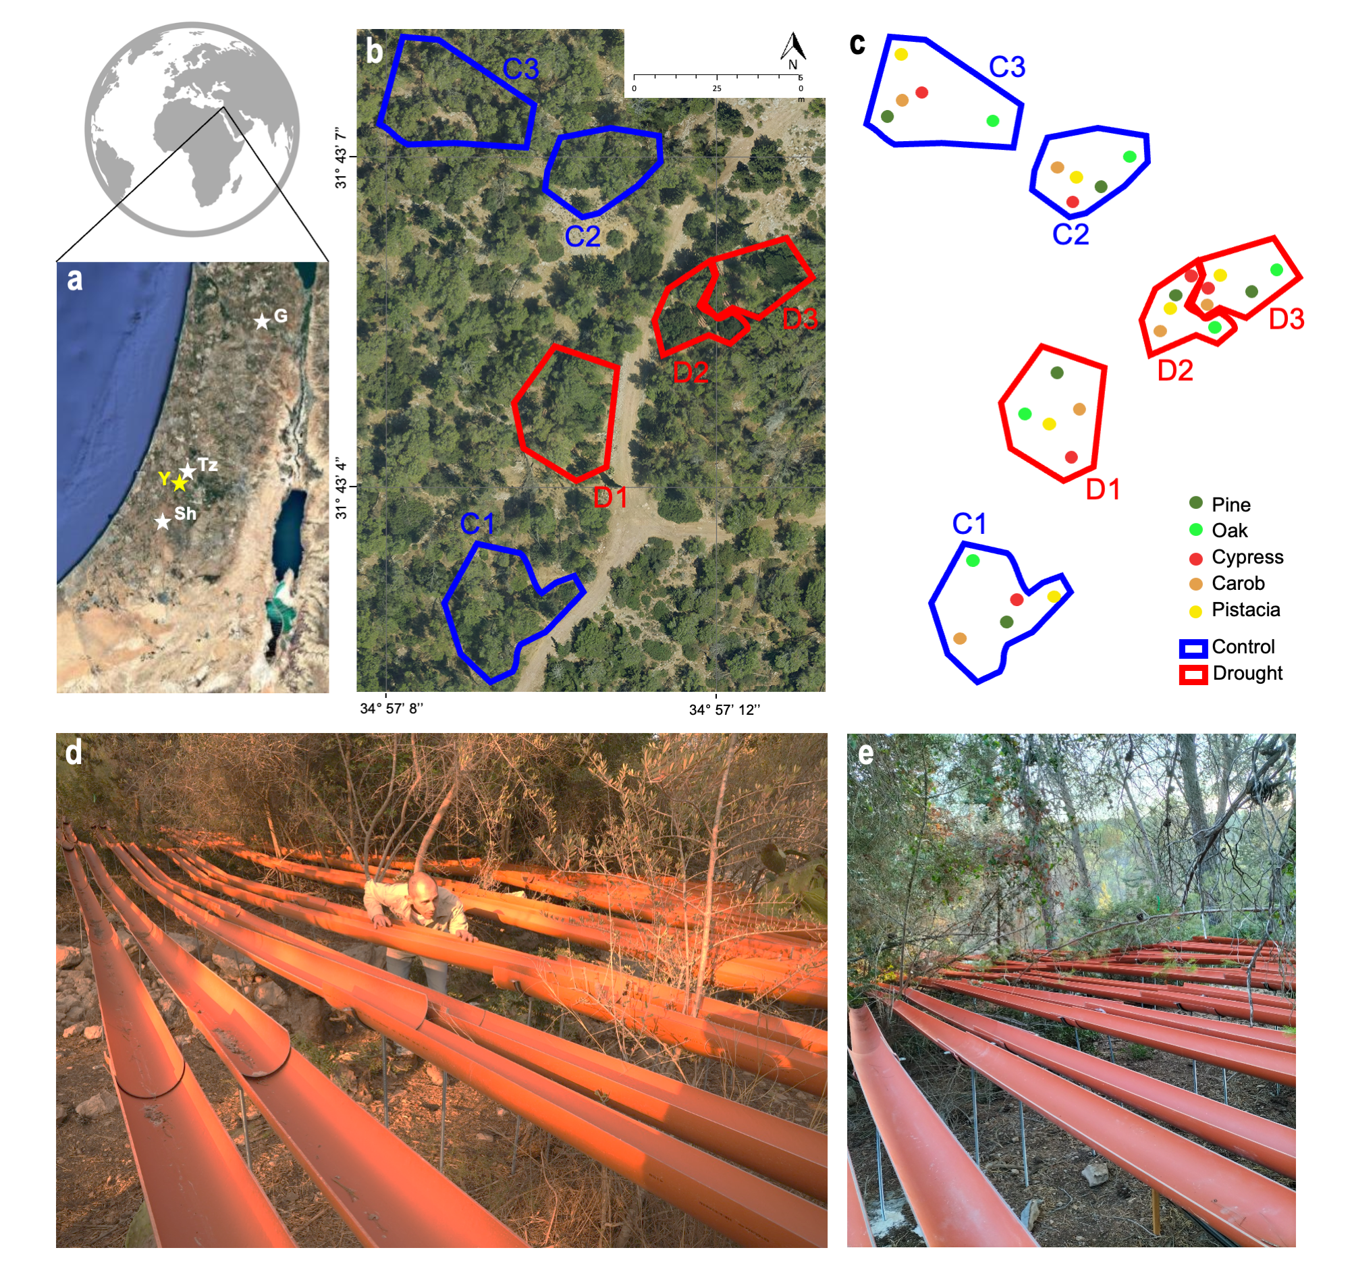
Figure 1. The study area showing (a) the experimental site of Yishi forst (Y; yellow star) and the three forest sites of Tzora (Tz), Shacharia (Sh), and Gilboa (G). (b) Aerial view of the 0.05-hectare plots at Yishi, with control plots in blue (C1-C3) and rainfall exclusion plots in red (D1-D3). (c) Same as (b) but with the tree species marked on the map. (d–e) The rainfall exclusion system in Yishi consisting of open-pipe gutters installed to divert approximately 50% of incident precipitation.
Notes:
Fig 1. Study area

Slide 2
Figure 2. Hyperspectral image preprocessing workflow for isolating tree canopy pixels, showing (a) original image of experimental plots with outlined areas of interest (canopy), non-representative pixels, and visible components of the rainfall exclusion system (black arrows). At first, (b) non-vegetated pixels are removed using an NDVI threshold of <0.3. (c) Then, to remove the shaded canopy portions, the near-infrared reflectance threshold of 0.07-0.2 was used.

Slide 3
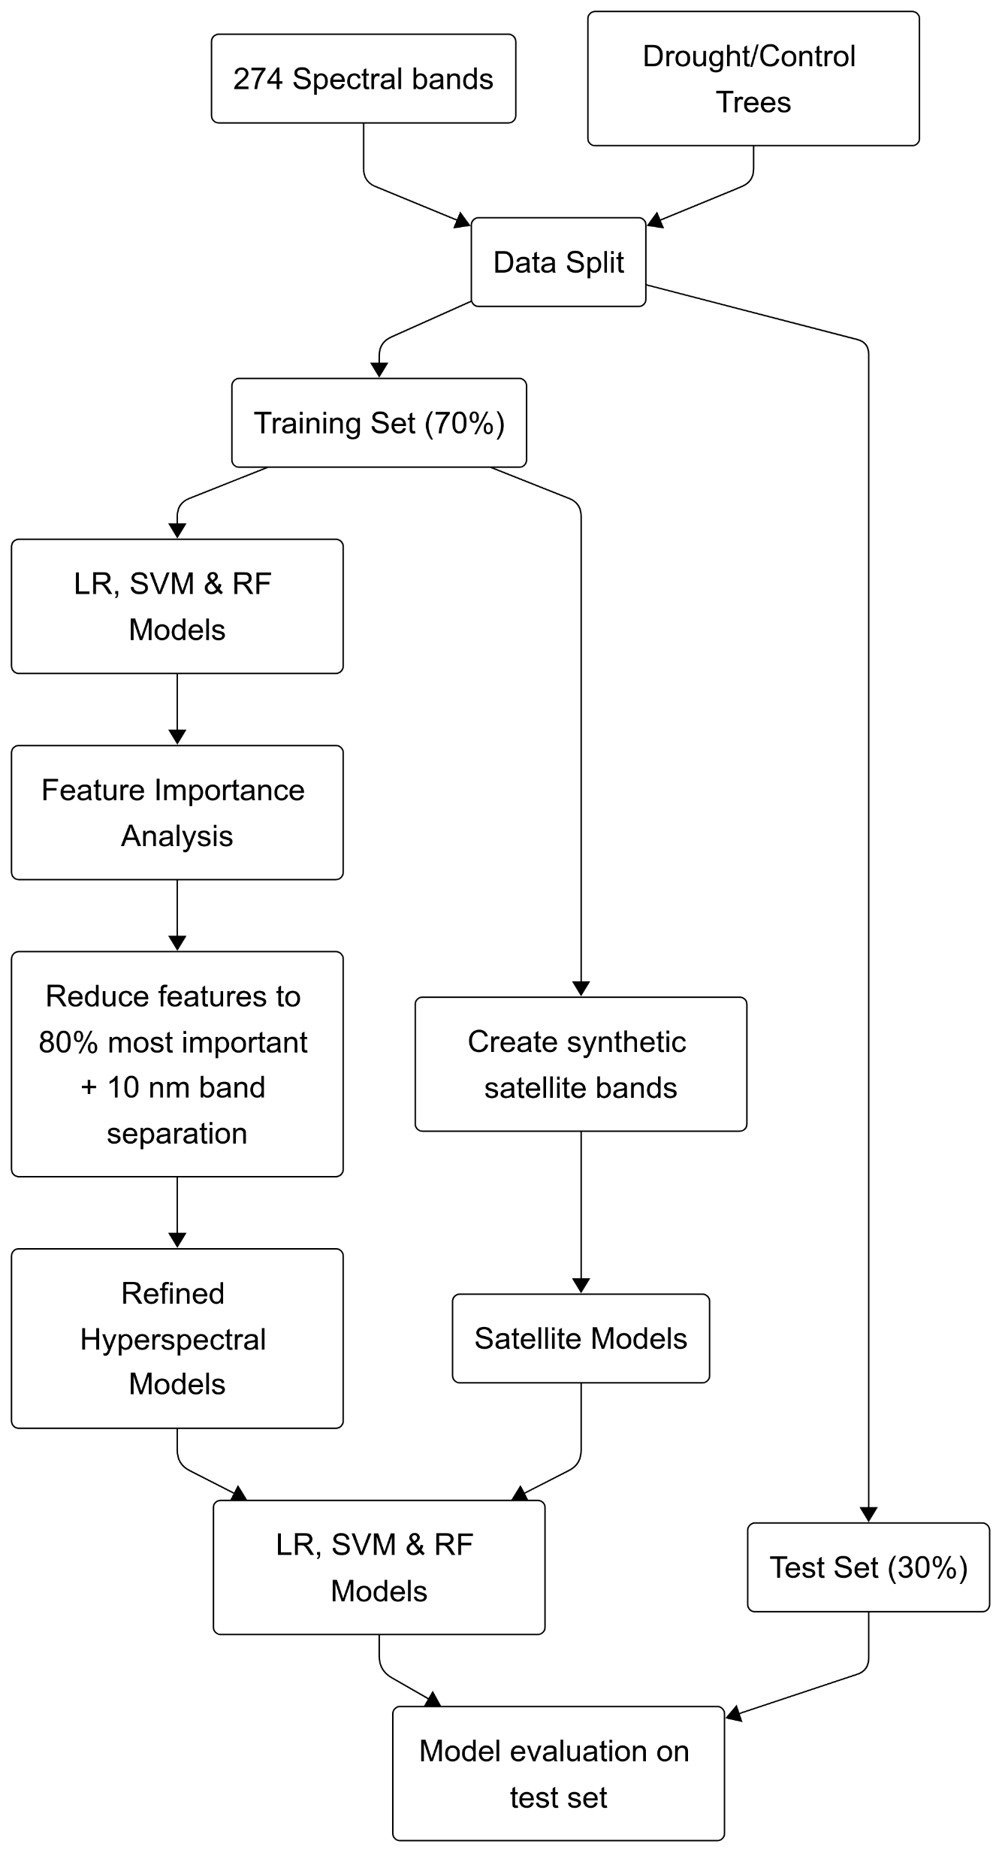
Figure 3. Workflow of the modeling framework, illustrating the use of inputs comprising 274 spectral bands from hyperspectral imagery and labeled drought/control trees, which were partitioned into training (70%) and test (30%) sets. The training data follows two parallel processing paths: (1) the hyperspectral pathway (left) where machine learning models are trained, followed by feature importance analysis and dimensionality reduction to retain bands representing 80% cumulative importance with 10 nm separation, resulting in refined hyperspectral models; and (2) the satellite simulation pathway (right) where synthetic satellite bands are created to train satellite-compatible models. Both refined hyperspectral and satellite models are evaluated using the same held-out test set to assess classification performance for drought stress detection.
(1)
(2)

Slide 4
Figure 4. Soil water content (SWC; %) dynamics in control and rainfall exclusion plots over the experimental period. The blue line represents the averaged SWC in control plots, and the red one represents the SWC in rainfall exclusion plots from January 2022 to March 2023. Horizontal dashed lines indicate the mean values across the entire period. The violin plot on the right displays the full distribution of soil moisture measurements for each treatment. Data were smoothed using a Savitzky-Golay filter with a window length of 21 and a polynomial order of 3 to improve the visualization of temporal trends.

Slide 5
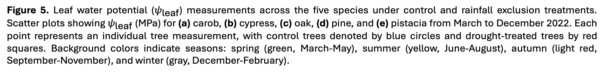
Figure 5. Leaf water potential ($ψ_{\text{leaf}}$) measurements across the five species under control and rainfall exclusion treatments. Scatter plots showing $ψ_{\text{leaf}}$ (MPa) for (a) carob, (b) cypress, (c) oak, (d) pine, and (e) pistacia from March to December 2022. Each point represents an individual tree measurement, with control trees denoted by blue circles and drought-treated trees by red squares. Background colors indicate seasons: spring (green, March-May), summer (yellow, June-August), autumn (light red, September-November), and winter (gray, December-February).

Slide 6
Figure 6. Histograms showing the frequency of predicted drought-stress risk probabilities for (a) Logistic Regression (LR), (b) Support Vector Machine (SVM), and (c) Random Forest (RF) models applied to the test dataset (N=74). Models were trained using a reduced hyperspectral feature set that contained only the top spectral bands, representing 80% of the cumulative importance. Blue bars represent control samples and red bars represent drought-treated samples. The vertical dashed red line at 0.5 indicates the classification threshold above which samples were classified as drought-stressed.

Slide 7
Figure 7. Application of SVM drought detection model to VENµS satellite imagery across three Mediterranean forest sites over multiple years. Each row represents a different forest: Tzora (top), Shacharia (middle), and Gilboa (bottom). Each column shows a different year (the year is indicated at the top right corner) with paired images: upper panels display the model's drought risk prediction (blue = low risk, red = high risk) and lower panels show corresponding RGB satellite imagery. White rectangular outlines (A and B) highlight areas of interest where the model predicted high drought stress risk (red pixels) before visible decline was visible. The color bar on the right indicates drought stress risk probability from 0 (low, blue) to 1 (high, red).

Slide 8
Supplement

Slide 9
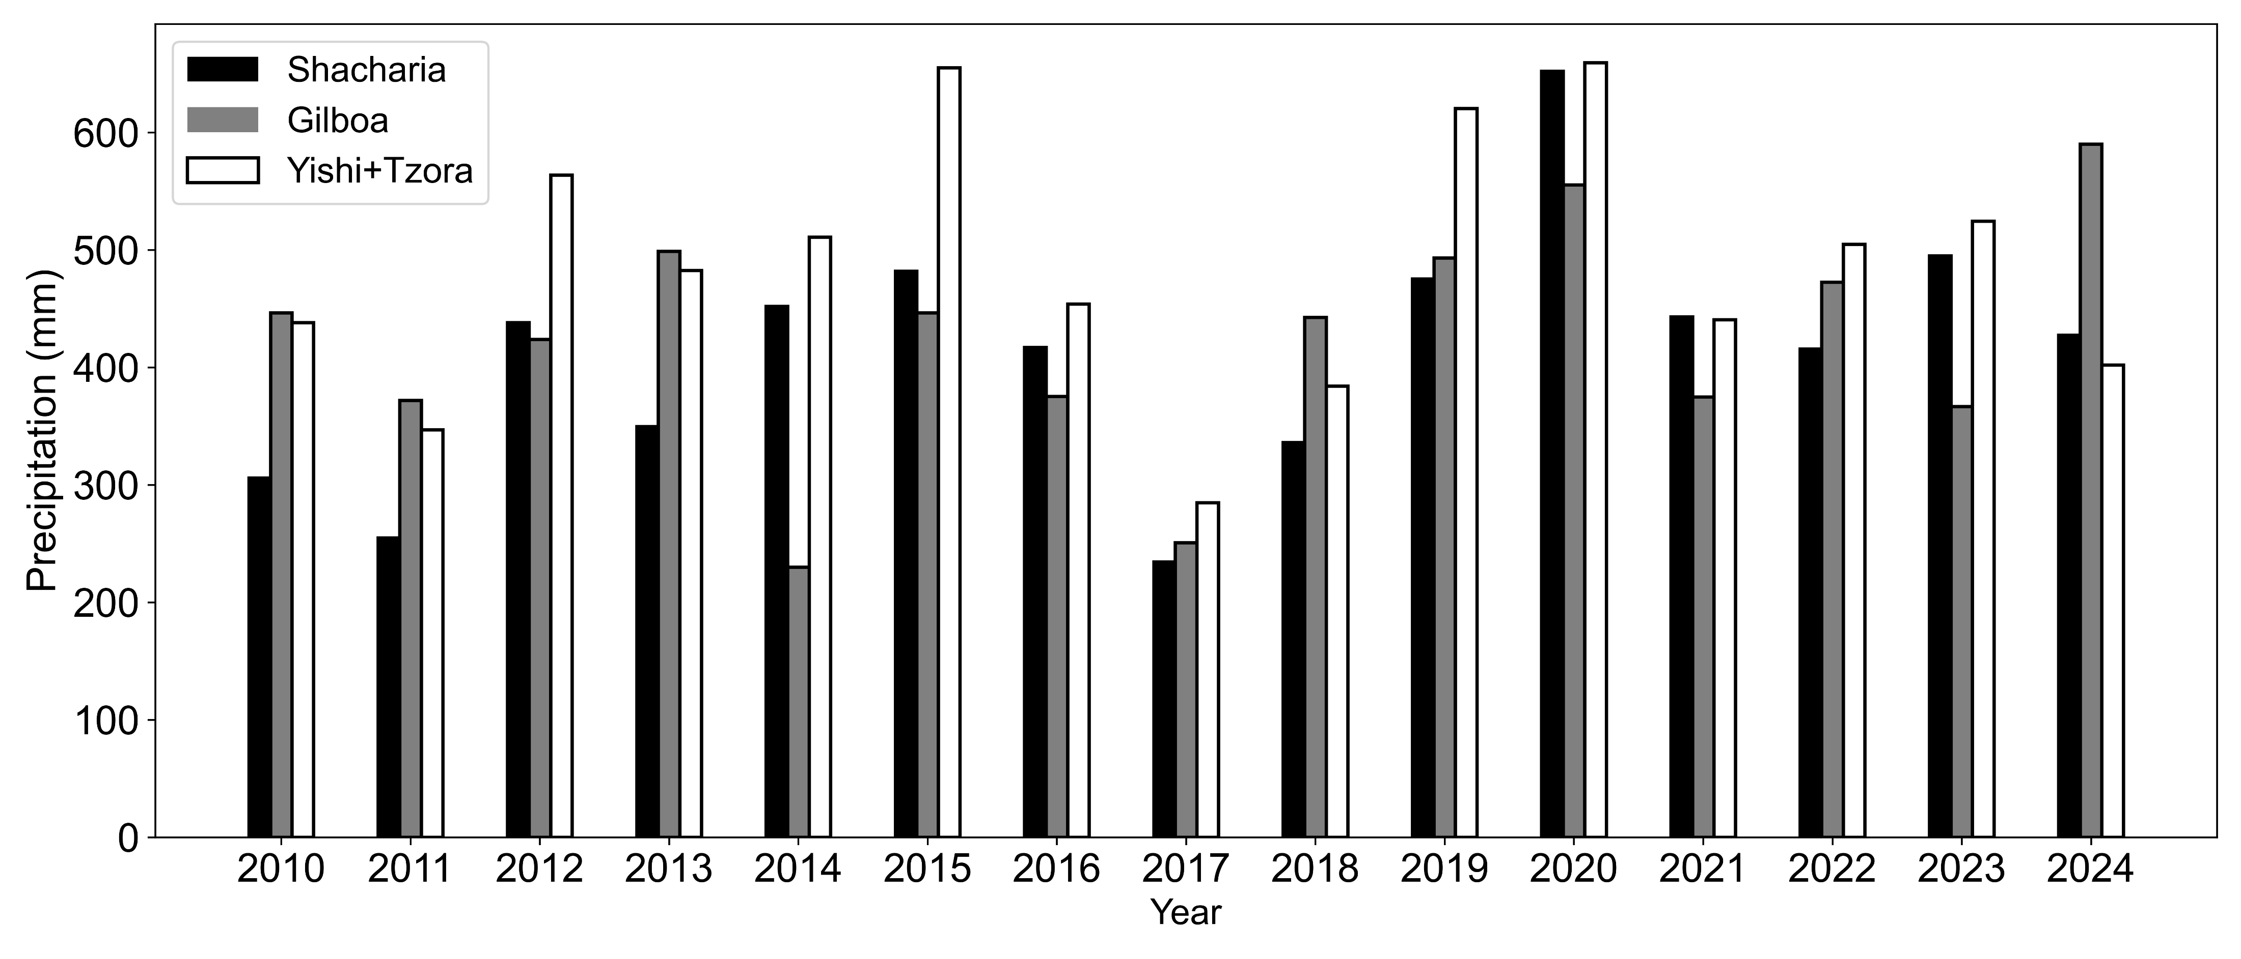
Figure S1. Annual precipitation at the three study sites from 2010 to 2024. Bar chart showing total annual precipitation (mm) recorded at meteorological stations near Shacharia (black), Gilboa (gray), and Yishi+Tzora (white) forests. Data were obtained from the Israel Meteorological Service stations located 4.8 km, 7.5 km, and 5.8 km from the respective forest sites. The year 2017 shows notably lower precipitation across all sites, representing a severe drought event that was used for model validation.

Slide 10
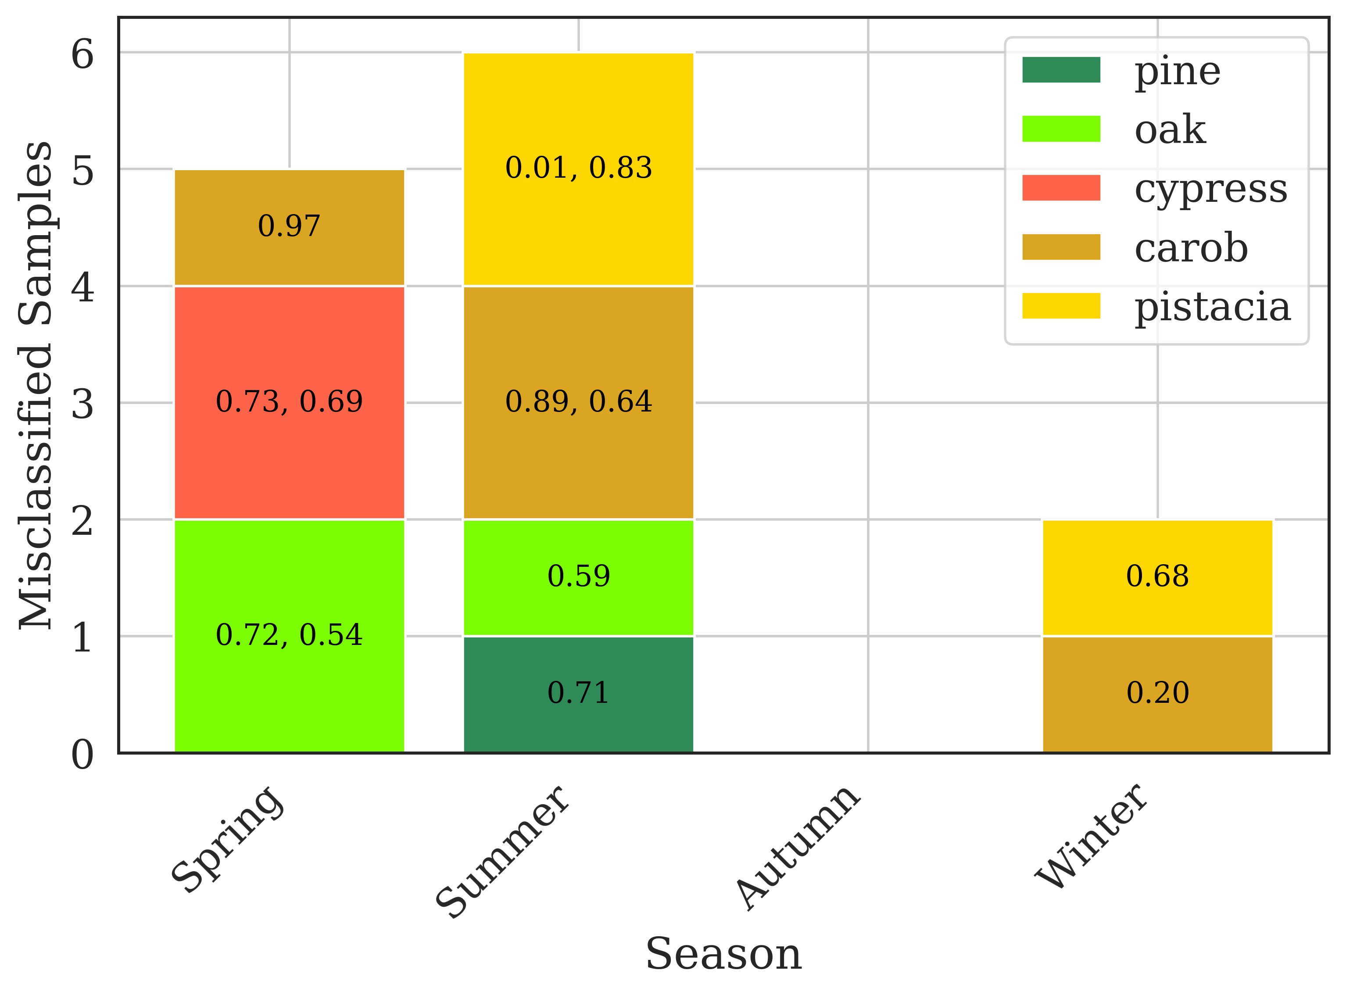
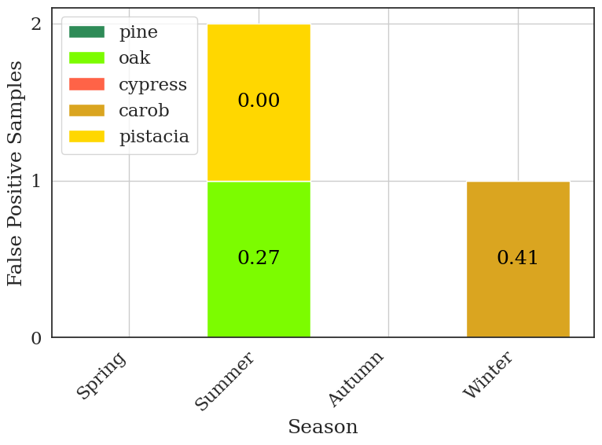
a
b
Figure S2. Seasonal distribution of misclassified samples from the Logistic Regression model with 80% feature importance. (a) Stacked bar chart showing all misclassified samples by season (spring, summer, autumn, winter) and tree species (pine, oak, cypress, carob, pistacia), with numbers indicating the model's drought probability score for each misclassified sample. (b) Stacked bar chart displaying only false positive samples (drought-stressed samples incorrectly classified as control) by season and species, with probability scores shown inside each bar segment. The number represents the score that the model assigned to each sample, where scores above 0.5 (50%) resulted in classification as drought-stressed.
Notes:
Fig S2: Misclassified samples of LR 80% importance per season and score for (a) all Misclassified samples and (b) false positive samples

Slide 11
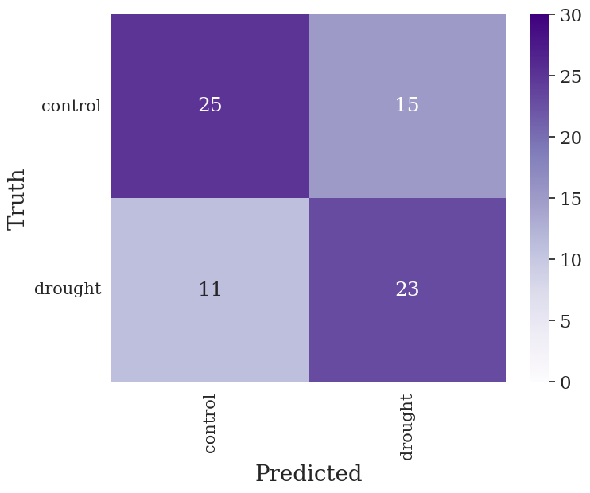
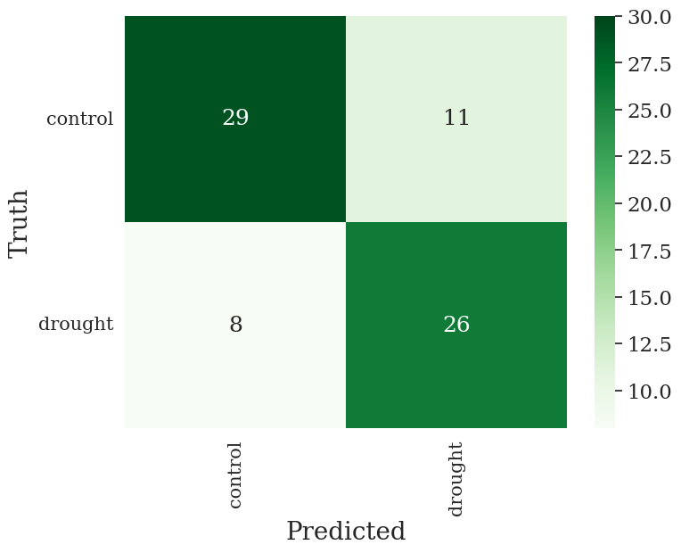
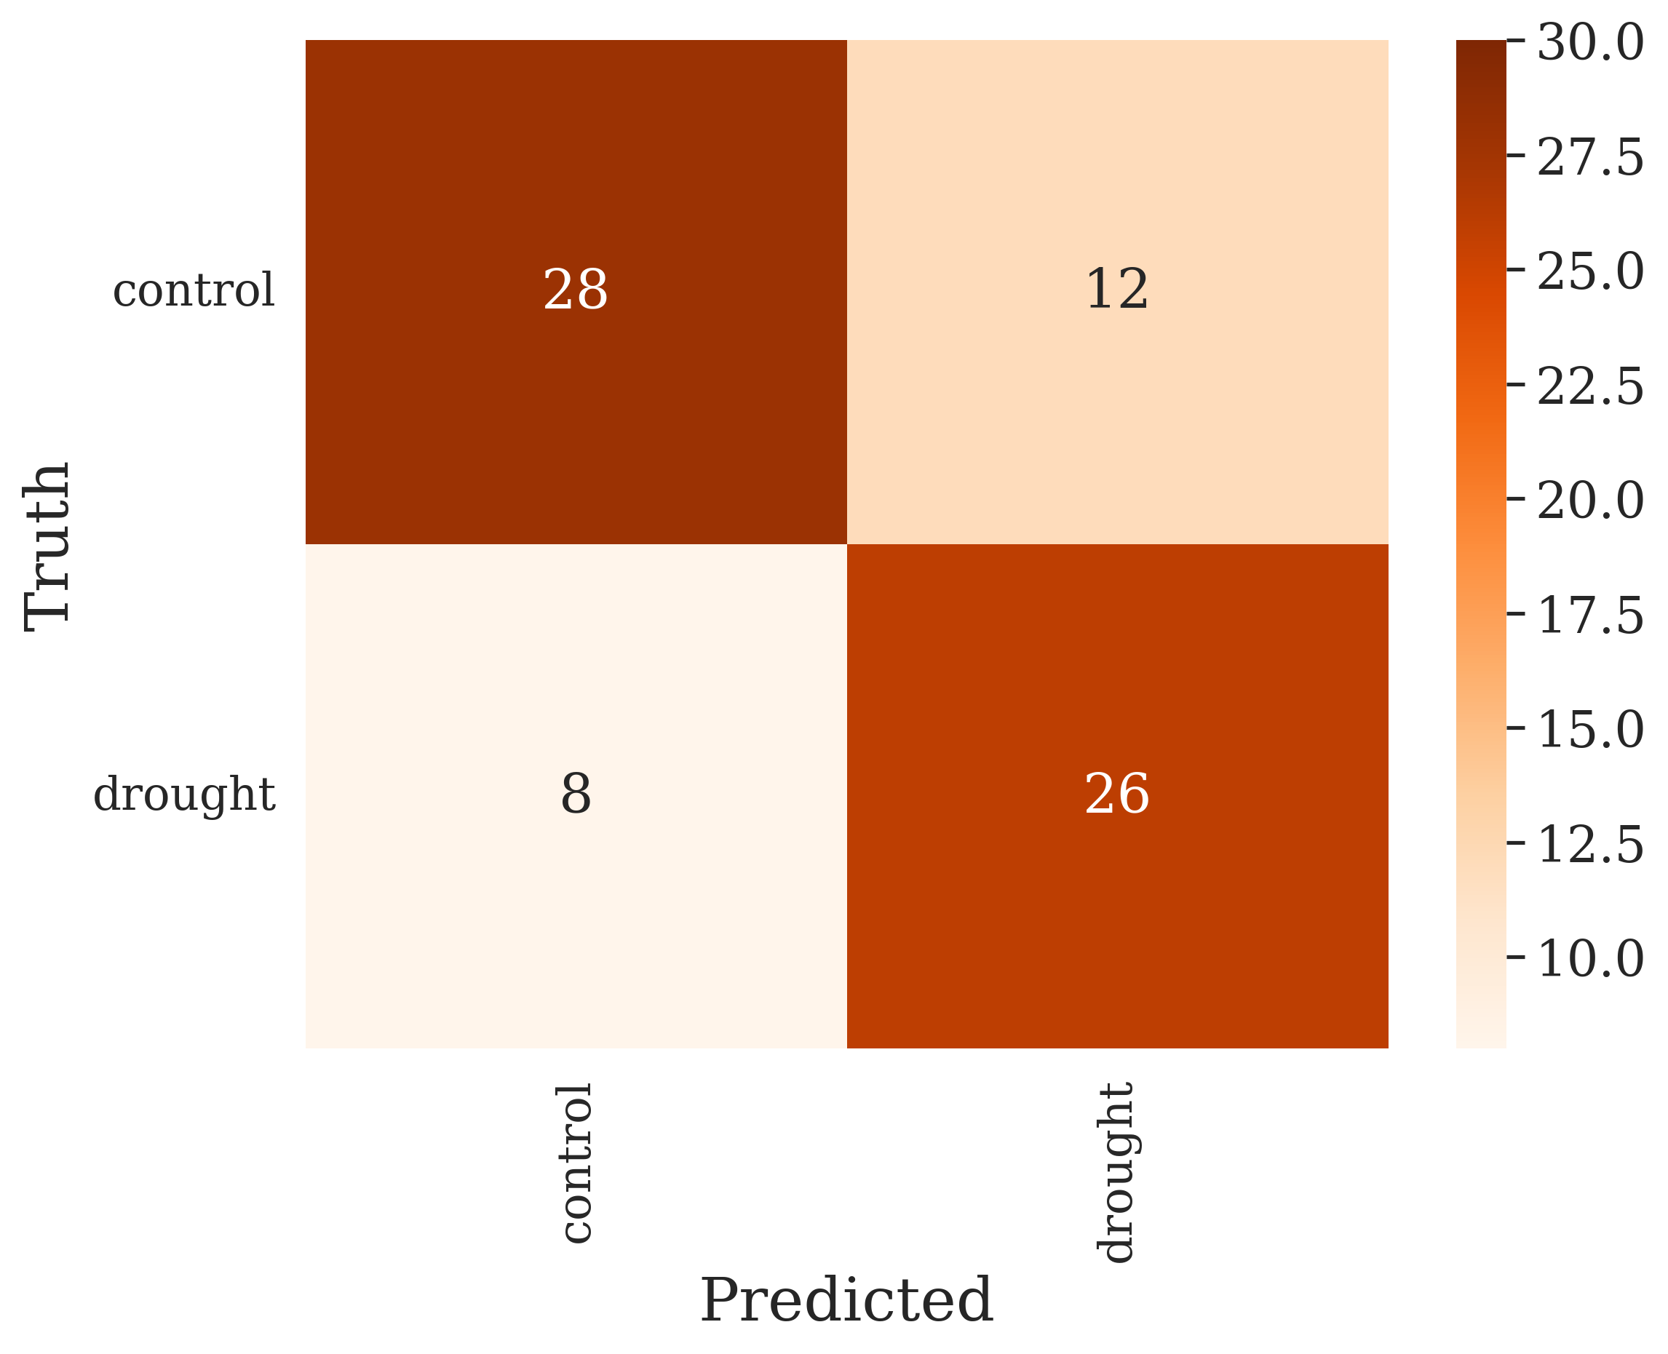
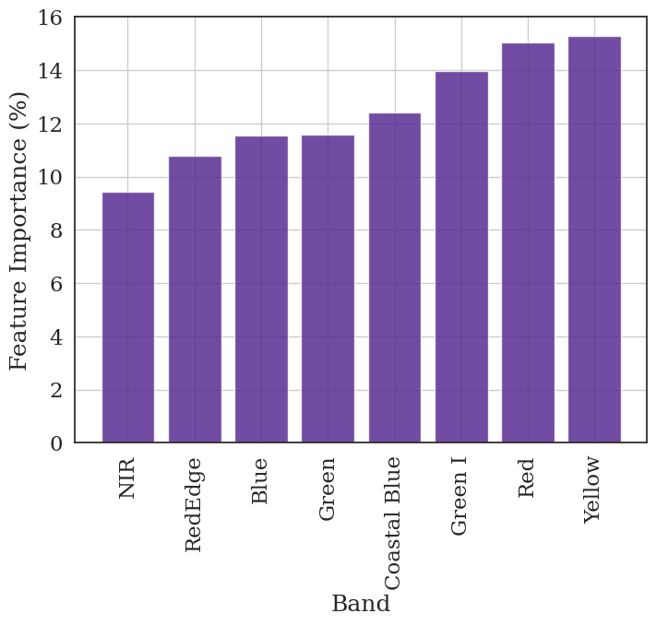
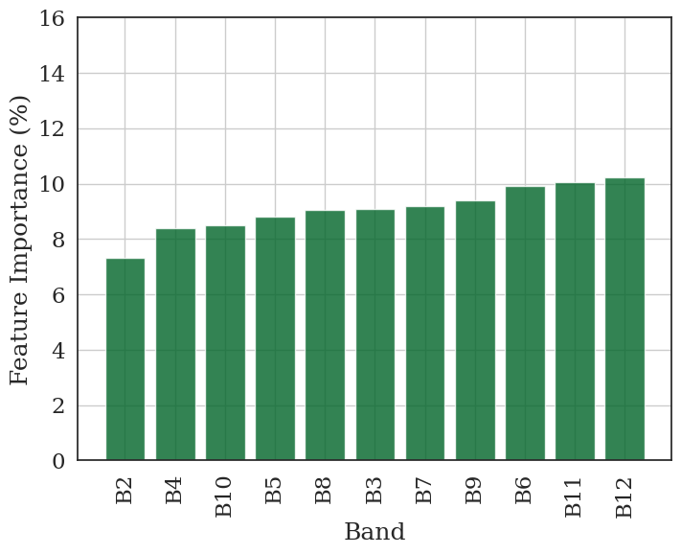
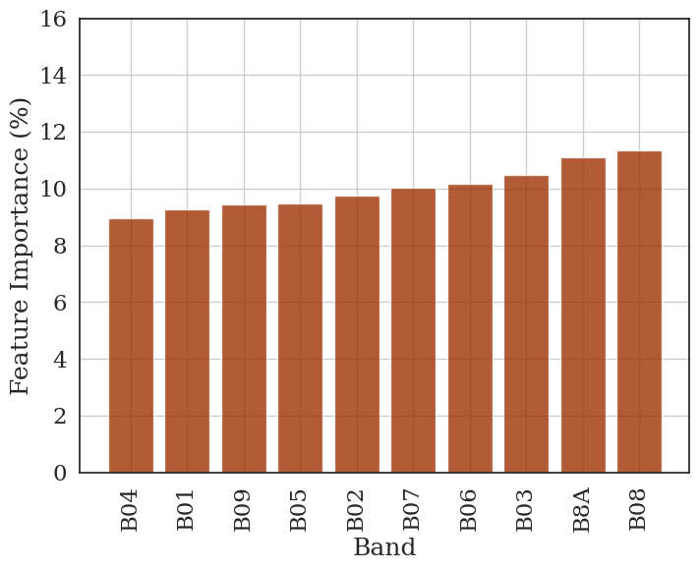
a
b
c
d
e
f
Figure S3. Confusion matrices and feature importance for SVM models trained on synthetic satellite spectral data. The top row shows confusion matrices for (a) Planet, (b) VENµS, and (c) Sentinel-2 satellite bands, displaying the number of samples correctly and incorrectly classified in each category (control vs. drought). Numbers in each cell represent the count of samples. Bottom row shows feature importance (%) for (d) Planet (purple), (e) VENµS (green), and (f) Sentinel-2 (orange) satellite bands.
Notes:
Fig. S3. Confusion matrix and feature importance of synthetic satellite data

